Slide 1
Industrial Land in Seattle a retrospective for the Planning Commission
April 12, 2018

Slide 2
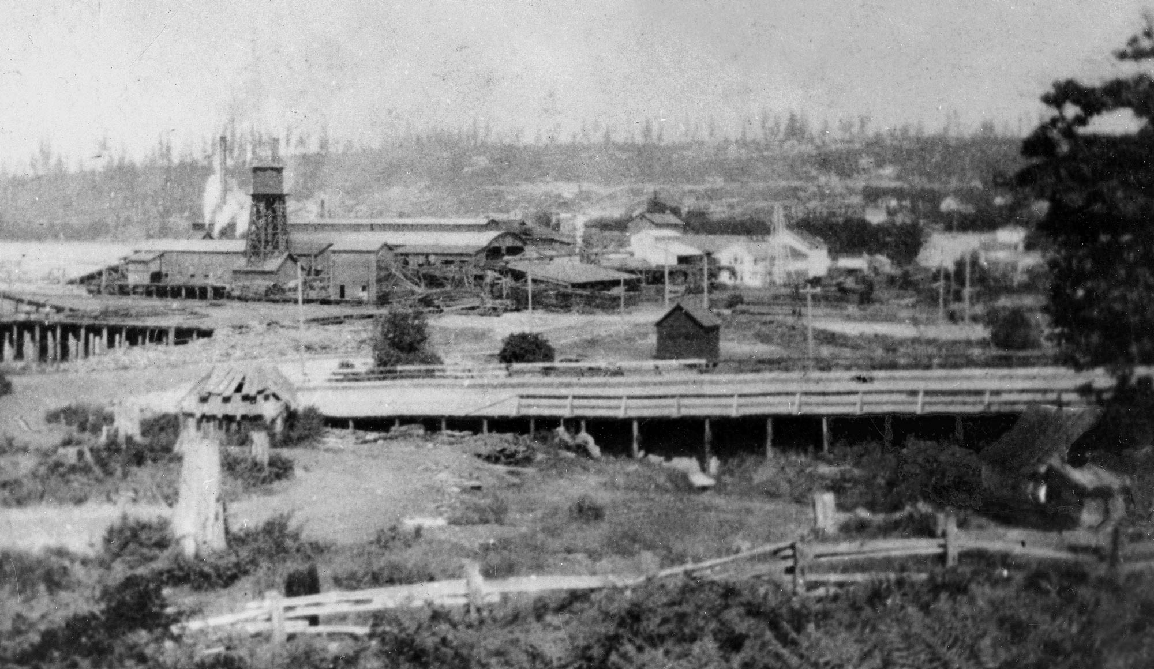
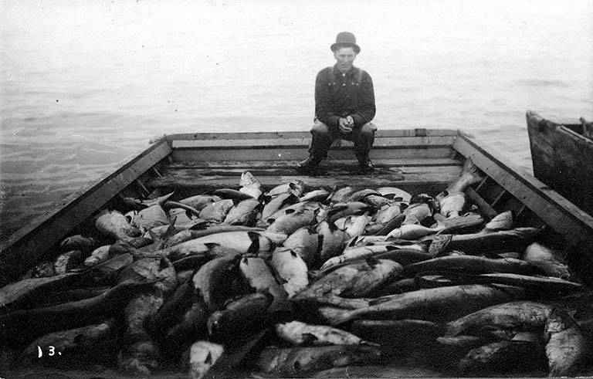
Early Resource Extraction

Slide 3
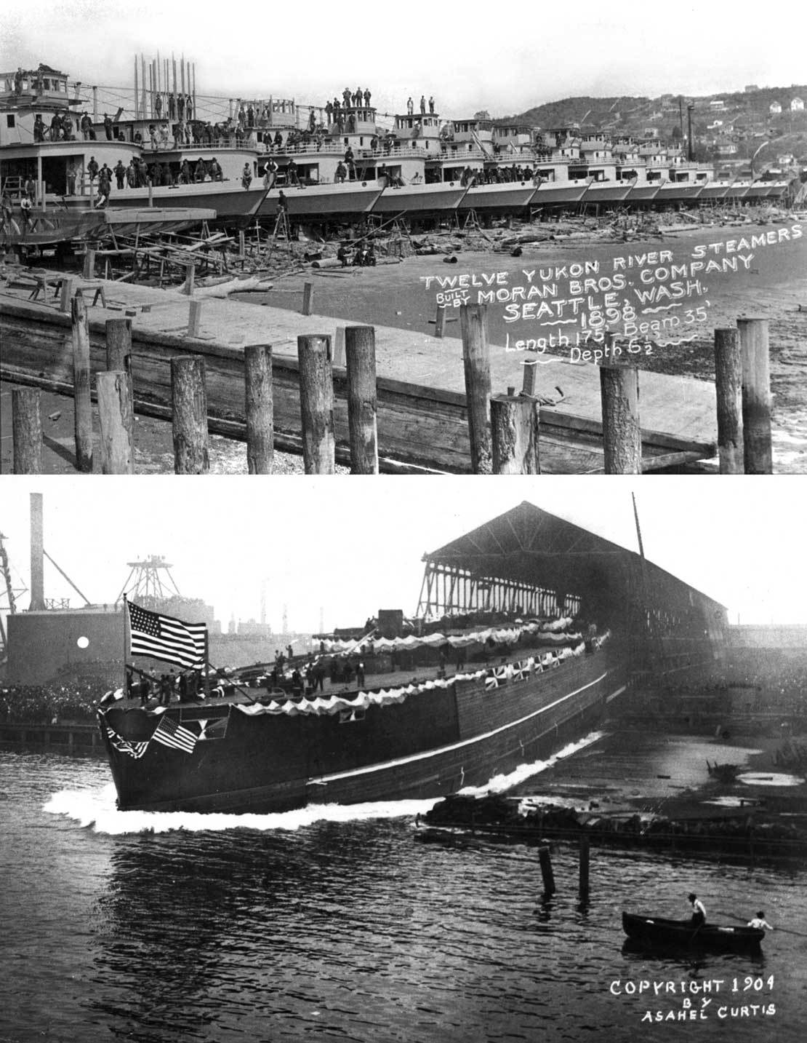
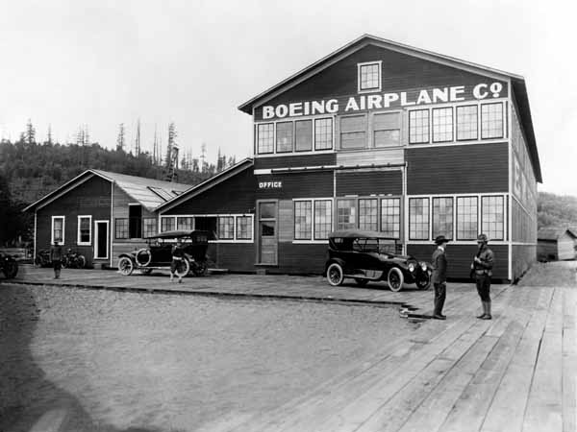
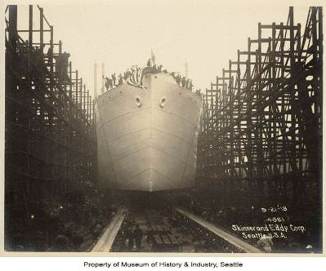
Early 20th Century - manufacturing

Slide 4
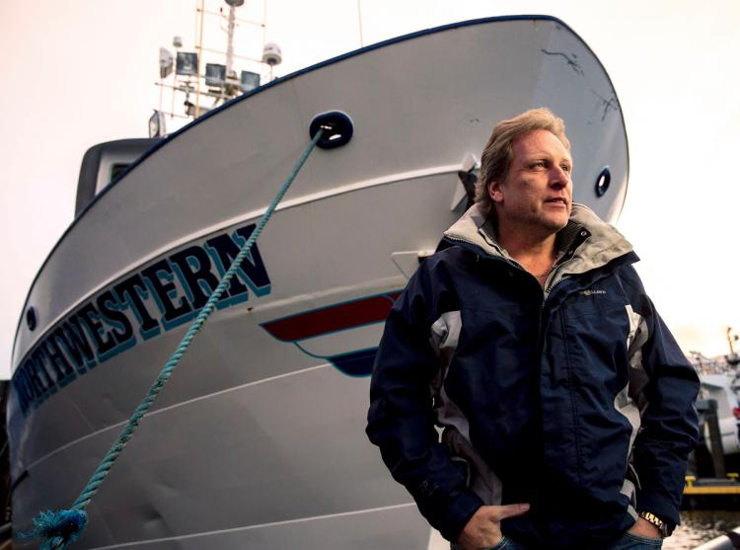

21st Century Resource and Manufacturing

Slide 5
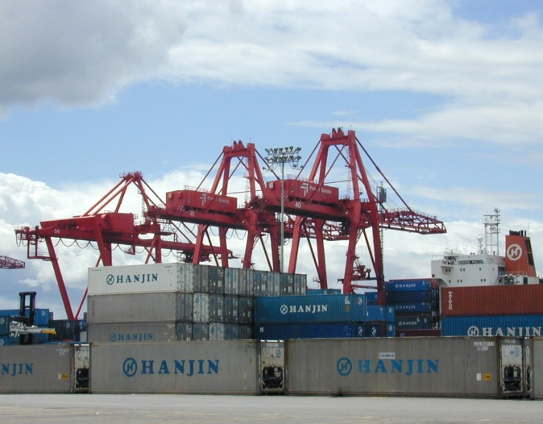
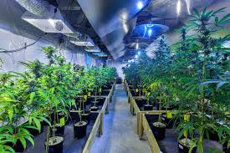
international and Domestic Trade

Slide 6
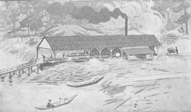
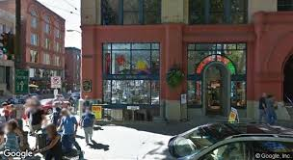
Evolution of Seattle’s Industrial Land
Replaced by “Magic Mouse”
Yesler Mill, 1852

Slide 7
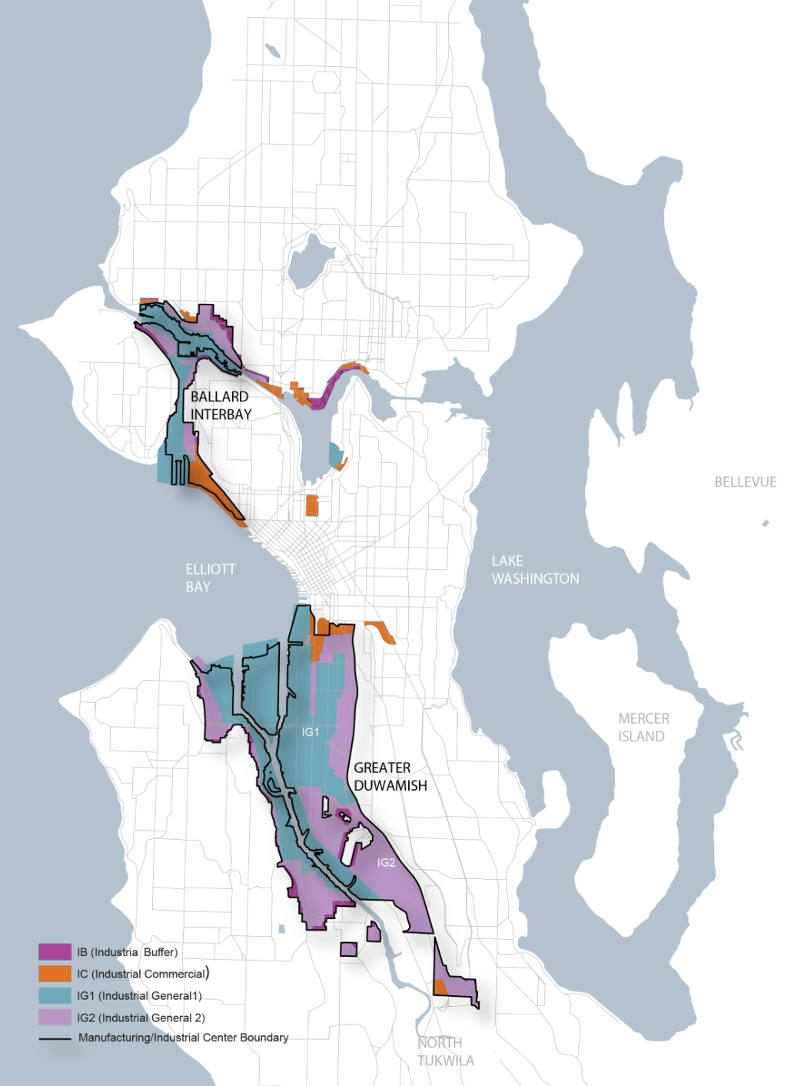
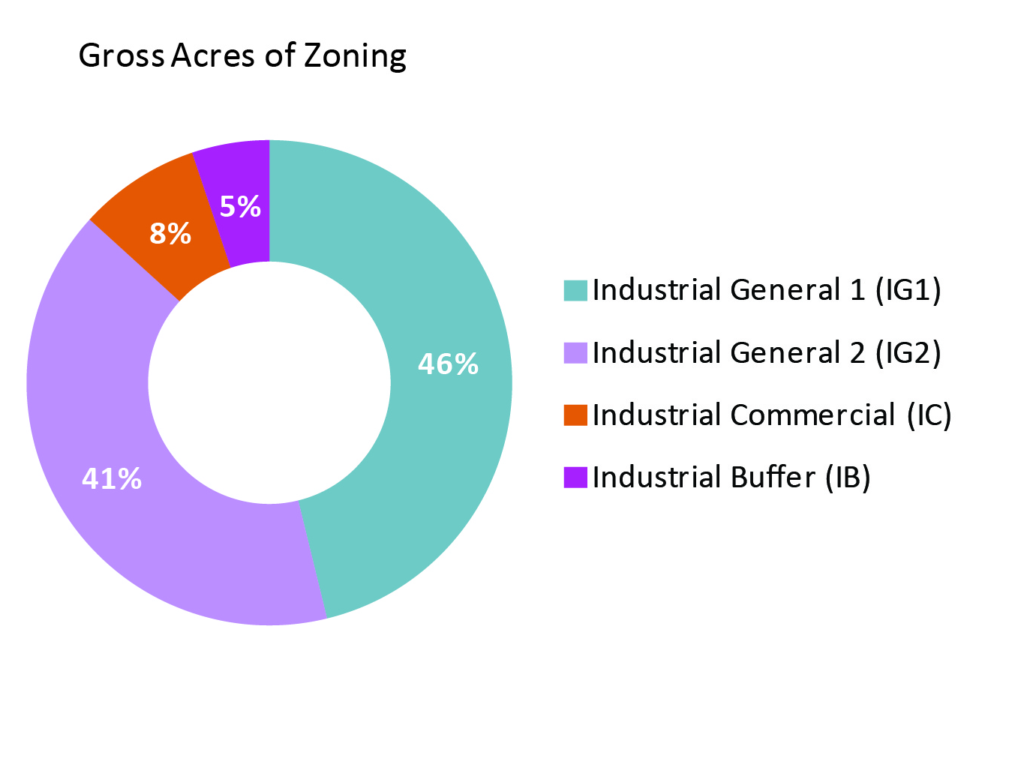
INDUSTRIAL ZONING

Slide 8
Policy guidance
Comp Plan says:
Promote the use of industrial land for industrial purposes.
Promote high value-added economic development by supporting growth in the industrial and manufacturing employment base.
Restrict or prohibit uses that may negatively affect the availability, character, or function of industrial areas.

Slide 9
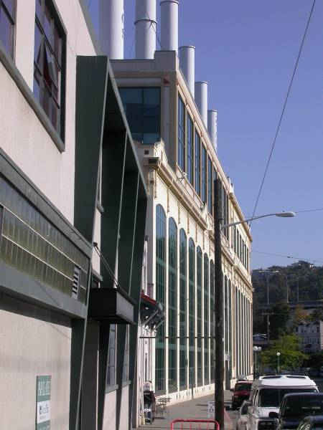
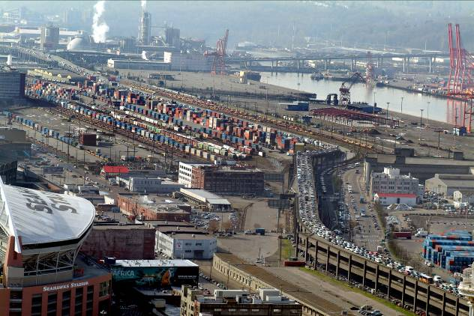
Land use code change - 2007
Reduced maximum size of retail and office uses to 25,000 and 10,000 sq. ft.
Previous maximum sizes had been as high as 100,000 sq. ft.
Notes:
Planning Department and Mayor decided to call the question on whether to increase protection of industrial land
Very contentious land use battle (most lawyers and public affairs consultants ever)
Lowered max size of office and retail use from highs of 100K and 75K to 25K and 10K
To ratchet down real estate competition and speculation
Send a message that city stands behind the long-standing policy language

Slide 10
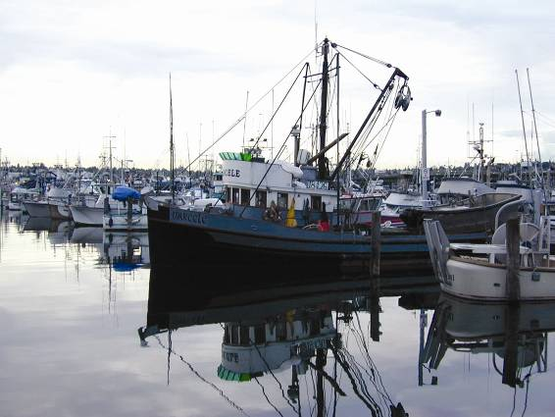
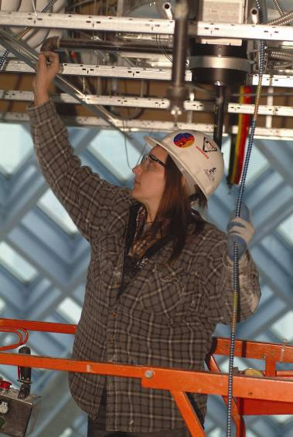
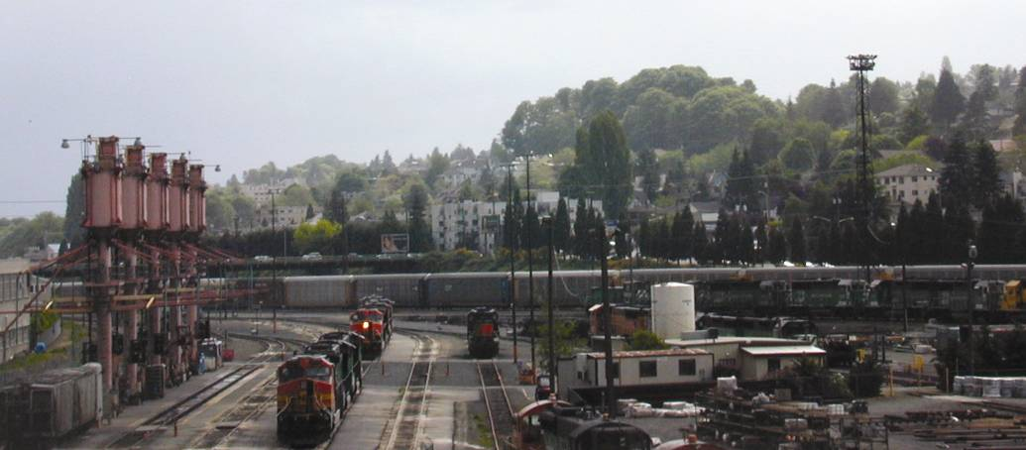
Why does the city care?
Growth Management
Healthy Economy
Efficient infrastructure
Revenue
Notes:
More than 20 years – strong policy about preserving industrial land for only industrial uses
Re-evaluation over last 2 years led to reaffirming and strengthening that commitment based on
Growth management strategy
Ensuring Healthy economy
Using infrastructure efficiently
City revenue

Slide 11
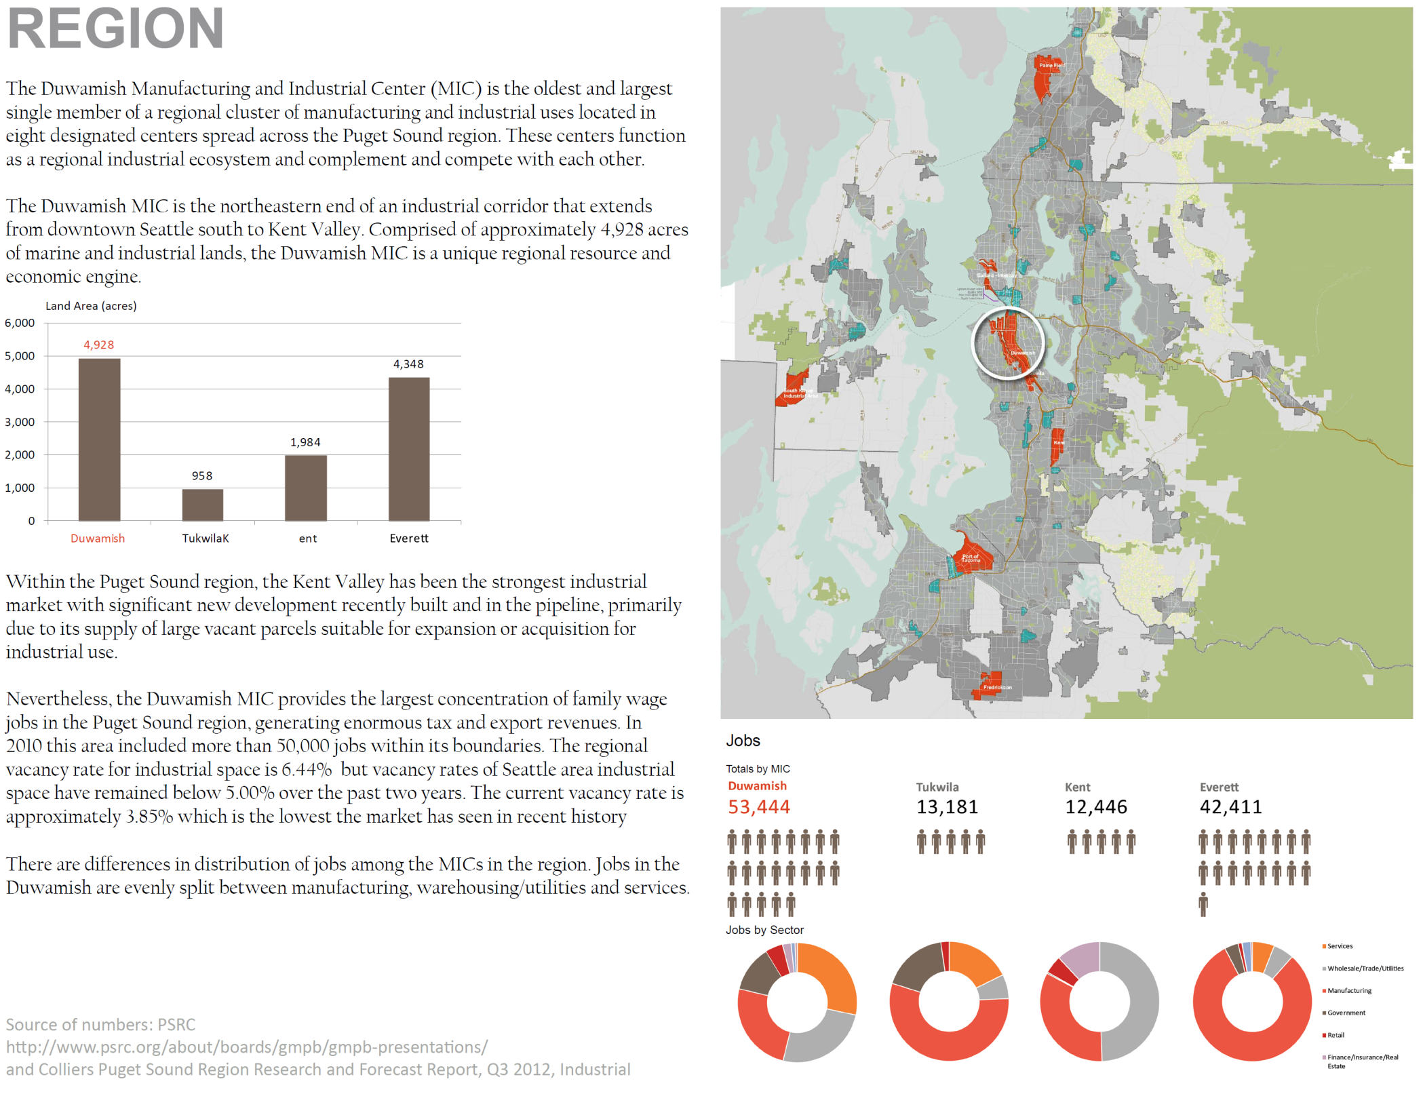

Slide 12
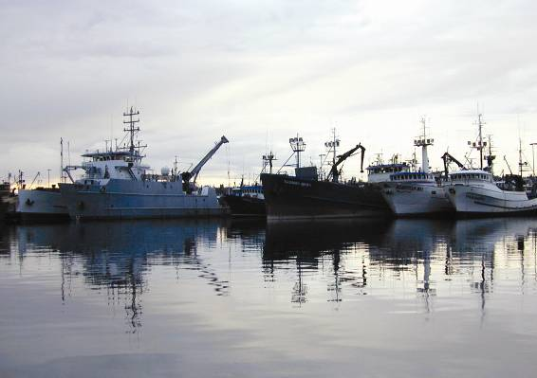
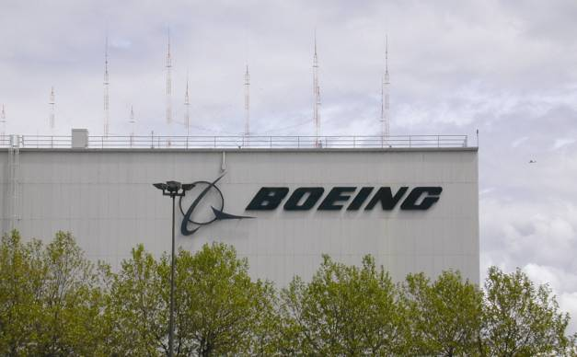
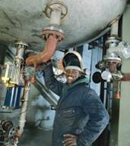
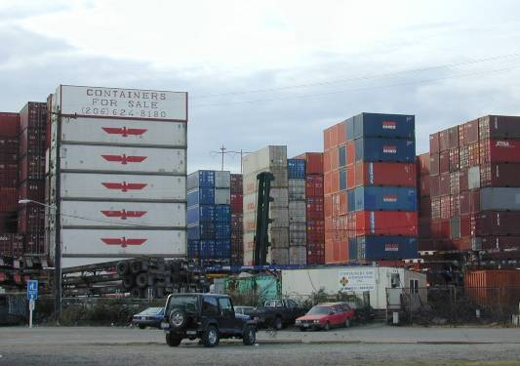
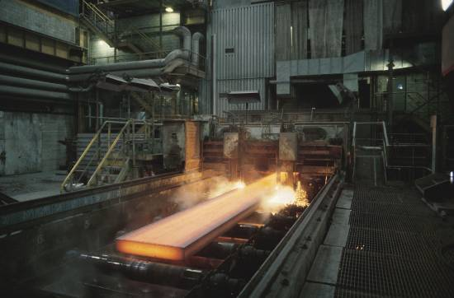
Healthy Economy
Economic Diversity Contributes to Resilience
Notes:
Industry supports a diverse economy
700-ship North Pacific fishing fleet, shipbuilding, repair and services
Boeing contractors
One of the largest container teminals on west coast
Garage and workshop for the city

Slide 13
Healthy Economy
About 1/6 of city employment
Industrial wages are ~20% above citywide average
>70% require high school or less education
Notes:
Employment forecasts from the regional MPO indicate industrial employment will continue to increase over next 30 years.
Seattle is one of few American cities to experience mfg growth since 2004

Slide 14
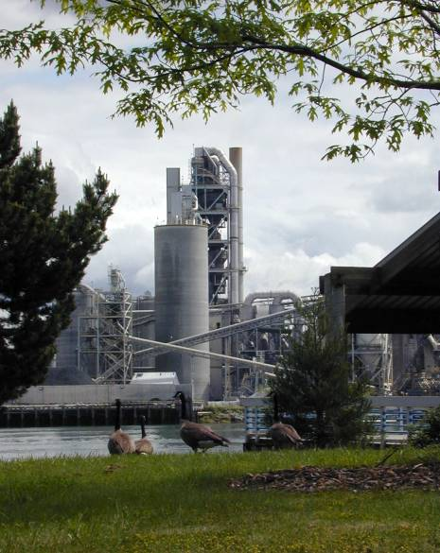
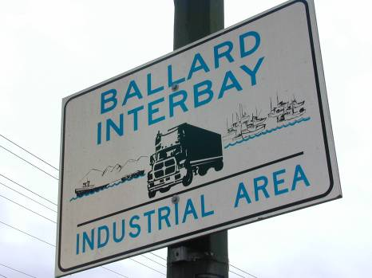
Healthy Economy
12% of City zoned Industrial
26% of firms in current location < 5 years
27% of firms in current location > 30 years
Industrial vacancy rate currently under 2% and consistently lower than other sectors
Notes:
12% of City’s land produces
20% of current employment
Mix of old and new companies
Very low vacancy, lowest in region (even with slightly higher rents)

Slide 15
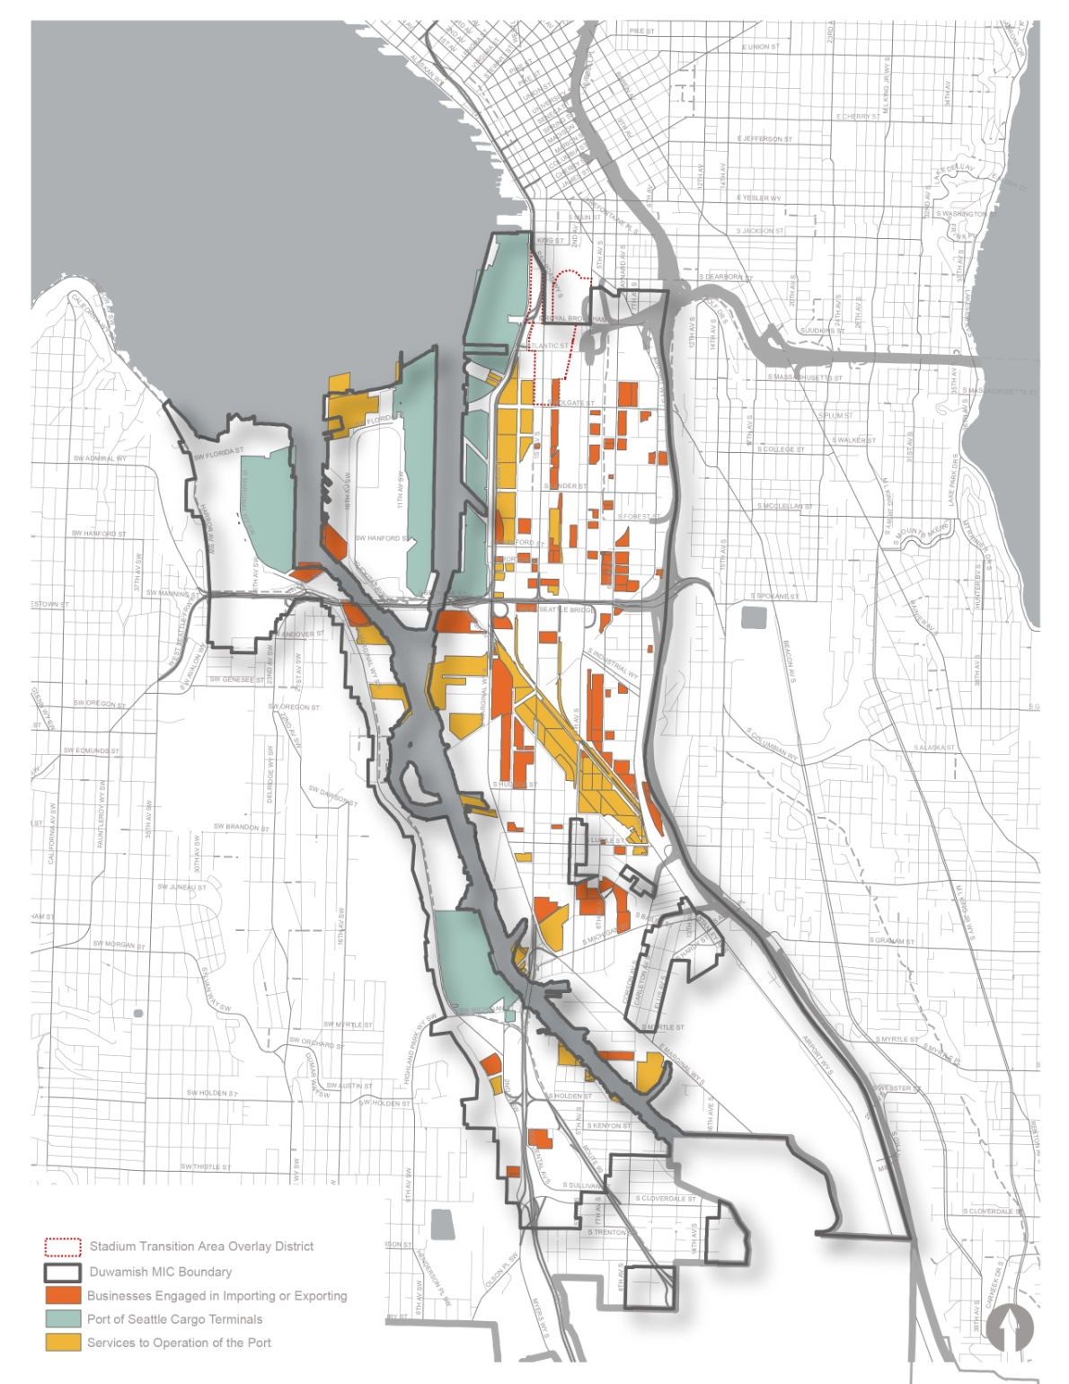
Infrastructure Investment
Over $800 million in container terminal upgrades
4.2 million bushel grain terminal
State highway connecting container terminals to I-5 and I-90
3 separate rail yards
Notes:
Taking advantage of existing infrastructure
Significant investments in upgrading container terminals
Recent highway from container terminals to 2 interstate freeways
Major grain terminal
Rail yards and main line service
Airport – primarily cargo carriers

Slide 16

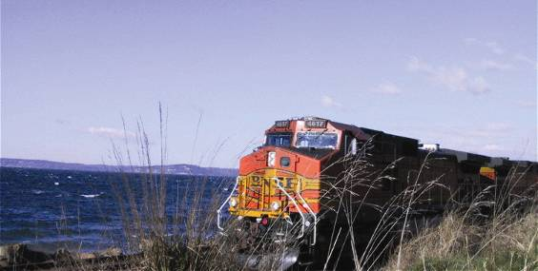
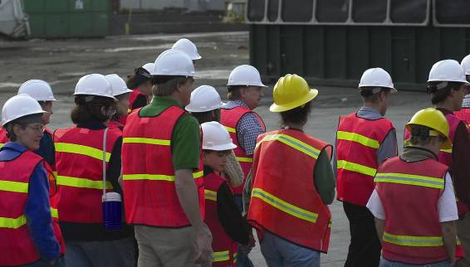
City Revenue
33% of City sales tax
32% of City B & O tax
87% of utility tax
18% of property tax

Slide 17
Environmental concerns
Poor infrastructure, especially for non-industrial activities
Contamination from previous uses
Sea-level rise

Slide 18
Why think about changing Industrial Land?
Growth needs land
Desire for less expensive buildable land
Frequent requests to redesignate industrial land on FLUM
Speculation
Take advantage of light rail stations

Slide 19
Previously Proposed Comp Plan Policy 1
Criteria for reviewing requests to remove land from a M/IC:
  Specify the use for the land
  Demonstrate there is no other land in the city suitable for that use
  Proposed use would not replace an industrial use
  Proposed use would not interfere with nearby industrial operations

Slide 20
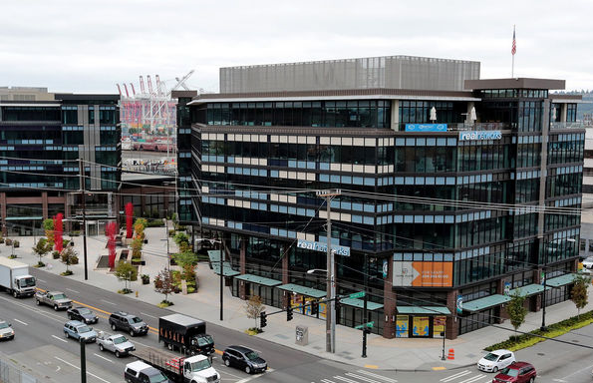
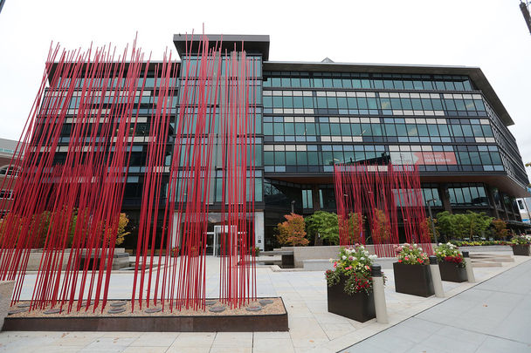
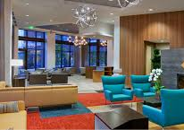
Previously Proposed Policy 2
Prohibit future use of Industrial/
Commercial (IC) zone in M/ICs

Slide 21
Mayor’s Industrial Lands Advisory Panel
28 members
Equally divided between 2 camps – industry supporters and redevelopment advocates
Working group of 8 – 4 from each camp + staff from OED, DCI, OPCD, SDOT, OSE, DON
Full Panel has met about 6 times, working group sometimes every 2 weeks
Working group has developed draft recommendations

Slide 22
Advisory Panel Draft Concepts - OPCD
“SODO Concept” – gives an incentive of large amount of office space in exchange for providing ~1.0 FAR of new industrial space in limited portion of Duwamish MIC
I2C2 – study effectiveness of IB, IC, C1 and C2 zones citywide and consider changes, consolidation, remapping
Area studies in Interbay, East Ballard and Georgetown
Adopt protective policies into Comp Plan or adjust FLUM process for land in MICs

Slide 23
Advisory Panel Draft Concepts – Other Departments
Platting and size-of-use regulations (SDCI)
Revise noise ordinance to favor industrial businesses (SDCI)
Increase funding for workforce training (OED)
Revive support for industrial businesses (OED/SDCI)

Slide 24
OPCD upcoming industrial Work
I2C2 beginning 2018
Subarea studies for Interbay, Ballard and G’town begin 2019
Feasibility study and EIS for SODO Concept under consideration

Slide 25
Additional Resources
Numerous Studies prepared by:
Seattle OED, DPD, City Council
Port of Seattle
Puget Sound Regional Council
Washington Maritime Federation
Urban Land Institute
Others

Slide 26

Questions ?
Tom Hauger, OPCD

